Slide 1
Monitor and Evaluate Policy Advocacy

Slide 2
Step 8: Develop Monitoring and Evaluation Plan
Purpose: demonstrate progress toward your goals and objectives and define success for advocacy strategy
Consider the factors that make M&E of advocacy different
Decide on methods for collecting data and measuring success
Develop indicators for your advocacy strategy

Slide 3
Monitoring and Evaluation Basics Common M&E Terms
Goals
Objectives
Indicators
Targets
Data/collection methods
Logic model
Inputs
Activities
Outputs
Outcomes
Impact
Performance monitoring plan (PMP)

Slide 4
“M” in M&E
Monitoring is the systematic process of collecting, analyzing, and using information/ data on specified project indicators to:
Track progress of project implementation
Track progress to reaching objectives
Account for the use of allocated funds
Guide management decisions
The information is used by project staff, management, and stakeholders.

Slide 5
“E” in M&E
Evaluation is the systematic collection and analysis of information about the characteristics and outcomes of programs to:
Make judgments, improve effectiveness, and inform decisions about current and future programming
Compare expected and achieved results
Examine contextual factors and causality to understand achievements or lack of achievement
Involves measuring changes in knowledge, attitudes, behaviors, skills, community norms, and use of services at the program or population level

Slide 6
Basic Logic Model Structure
Resources/ Inputs
Activities
Outputs
Outcomes
Impact
1
2
3
4
5
Your Planned Work
Your Intended Results

Slide 7
Logic Model Example—A Wedding
Inputs
Activities
Outputs
Outcomes
Impact
Couple
Hire Vendors
600 photos taken
Couple:
Is married
Enjoyed time with family and friends
Had fun on their special day
Stronger family bonds for couple
Budget
Write vows
1 marriage certificate signed
Stronger family bonds for the families
Venue
Get married
200 guests fed
Family and friends
Celebrate with friends and family
2 vows exchanged
Vendors
Go on a honeymoon
75 gifts received

Slide 8
Indicators
M&E requires the use of indicators.
Indicators define the data that you are collecting.
Example: number of people sensitized on GBV and GBV services
An indicator is a variable (its value changes) that measures the components of a program or project (inputs, activities, outputs, outcomes ).
Indicators can be quantitative or qualitative.

Slide 9
Characteristics of Good Indicators
Valid: accurate measure of a behavior, practice, or task that is the expected output or outcome of the activity
Precise: operationally defined in clear terms
Measurable: quantifiable using available tools and methods
Reliable: consistently measurable in the same way by different observers

Slide 10
Characteristics of Good Indicators (continued)
Comparable: can be measured in different contexts or time periods
Time-bound: requires completion by a specific date
Programmatically important: Why do we want to know this? Is the information useful?

Slide 11
Monitoring & Evaluation for Advocacy Work
Monitoring
Evaluation
Routine tracking of inputs and outputs
Measuring the changes resulting from program activities over time
Is the advocacy strategy being executed according to plan and on budget?
Are the activities still appropriate given external changes?
Is the advocacy having the intended effect on target audiences?
What are the successes and failures?
What is happening that you didn’t expect?
Source: Building on the Easy Wins: A Framework for Planning and Evaluating Proactive Long-Term Policy Advocacy. Health Policy Project; 2016.

Slide 12
Types of Indicators for M&E of Advocacy
Process/output indicators: numbers/types of activities and quality determinants—what you will do and how you will do it
Example: X different organizations contacted to participate in the coalition using best practices in engagement.
Interim outcome indicators: how you will know that attitudes, knowledge, and behavior of target audiences and allies have changed in the short and medium terms
Example: X new partners have shared coalition-approved messages with targets.
Long-term outcome indicators: the policy change for which you have advocated
Example: The local council approved policy change X with 85 percent of our preferred policy elements.
Source: Building on the Easy Wins: A Framework for Planning and Evaluating Proactive Long-Term Policy Advocacy, Health Policy Project, 2016.

Slide 13
Logic Model with Sample Indicators
Inputs
Activities
Outputs
Outcomes
Impact
Funding
Staff
Plans
Training materials
- Policy review
- Engage new partners in coalition
- Conduct community dialogues
- Health provider sensitization trainings
- Partners engaged in coalition
- Community dialogue held; topics listed
- Providers trained and scored on attitudes
- New partners actively sharing coalition messages
- Positive feedback from dialogues
- Improved attitude of providers
- Friendly services
Enabling environment increases access and use of services by PLHIV
# of partners engaged in coalition
# of new partners sharing messages of the coalition
# of PLHIV accessing services
Indicators:
# of partners contacted

Slide 14
Distinctive Features of Advocacy M&E
Time frames can be unpredictable
Strategies and milestones shift
Assessing progress and interim outcomes is important; not just impact
Context may define progress and outcomes
Demonstrate contribution to results, not simply attribution
Source: Advocacy Toolkit, UNICEF, 2010.

Slide 15
Methods to Evaluate Advocacy
Traditional
Unique
Interviews
Bellwether methodology
Champion tracking
Surveys
Intense period debriefs
Media scorecards
Focus groups
Critical incident timelines
360-degree critical incident reviews
Event observation
Systems mapping
Research panels
Polling
Policymaker ratings
Social media tracking
Case studies
Intercept interviews
Rapid response research
Source: Building on the Easy Wins: A Framework for Planning and Evaluating Proactive Long-Term Policy Advocacy. Health Policy Project; 2016.

Slide 16
Method: Policymaker Ratings
Support
Influence
Confidence
1=Not at all supportive
2=Interested
3=Somewhat supportive
4=Supportive
5=Extremely supportive
1=Not very influential
2=Somewhat influential
3=Influential
4=Extremely influential
1=Not very confident in the rating
2=Somewhat confident
3=Extremely confident
NOTE: You must identify observable characteristics or behaviors that differentiate each “level” on the scale for consistency between raters and ratings.
Developed by: Julia Coffman, Harvard Family Research Project.

Slide 17
Method: Systems Mapping
Step 1
Step 2
Step 3
Useful when trying to track systems change
Mapping of the parts and relationships of a system
Can involve mapping of a system, key informant interviews, or network analysis
Adapted from: Measuring Up, A Guide for Learners. AIDS Alliance; 2010.

Slide 18
Example 1
Problem Statement: PLHIV in Malawi denied access to care, treatment, and support
Advocacy Goal: Equal access to high-quality health services for all PLHIV in Malawi
Advocacy Objective: MOH commits to adopting a policy of providing high-quality health services to all PLHIV
Indicator: MOH resolution published by March 2020 on provision of high-quality services for all PLHIV
Activities
1: Analyze data on current quality of health care services for PLHIV
2: Develop briefing paper on current status of care and potential impact of changed policy
Indicator: Briefing paper written on the status and quality of health care services for PLHIV based on current data, and potential impact of changed policy
3: Present data and briefing paper to MOH technical working group at quarterly meeting
Indicator: Presentation developed and delivered to MOH during quarterly meeting
Adapted from: A2 Analysis and Advocacy, Advocacy Training Manual, Health Policy Initiative, 2007.

Slide 19
Example 2
Problem Statement: Lack of government commitment (policy and resources) to the national HIV and AIDS program, which has limited HIV services for the general population
Advocacy Goal: Adoption of national HIV and AIDS policy and allocation of appropriate resources for its implementation
Advocacy Objective: National AIDS Council (NAC) will draft and submit a National HIV and AIDS Policy and Operational Plan for approval within one year
Indicator: National HIV and AIDS Policy and Operational Plan submitted to MOH for approval
Activities
1: Conduct stakeholder meeting to gather input about activities to include in the plan
Indicator: Draft list of activities developed as a result of stakeholder meeting
2: With research partners, review plans of other countries and develop a briefing note on important considerations for the NAC
3: Develop a website to track commitments by the NAC of what will be included in the plan and progress toward completion
Indicator: Tracking website developed with initial commitments of the NAC
Adapted from: A2 Analysis and Advocacy, Advocacy Training Manual. Health Policy Initiative; 2007.

Slide 20
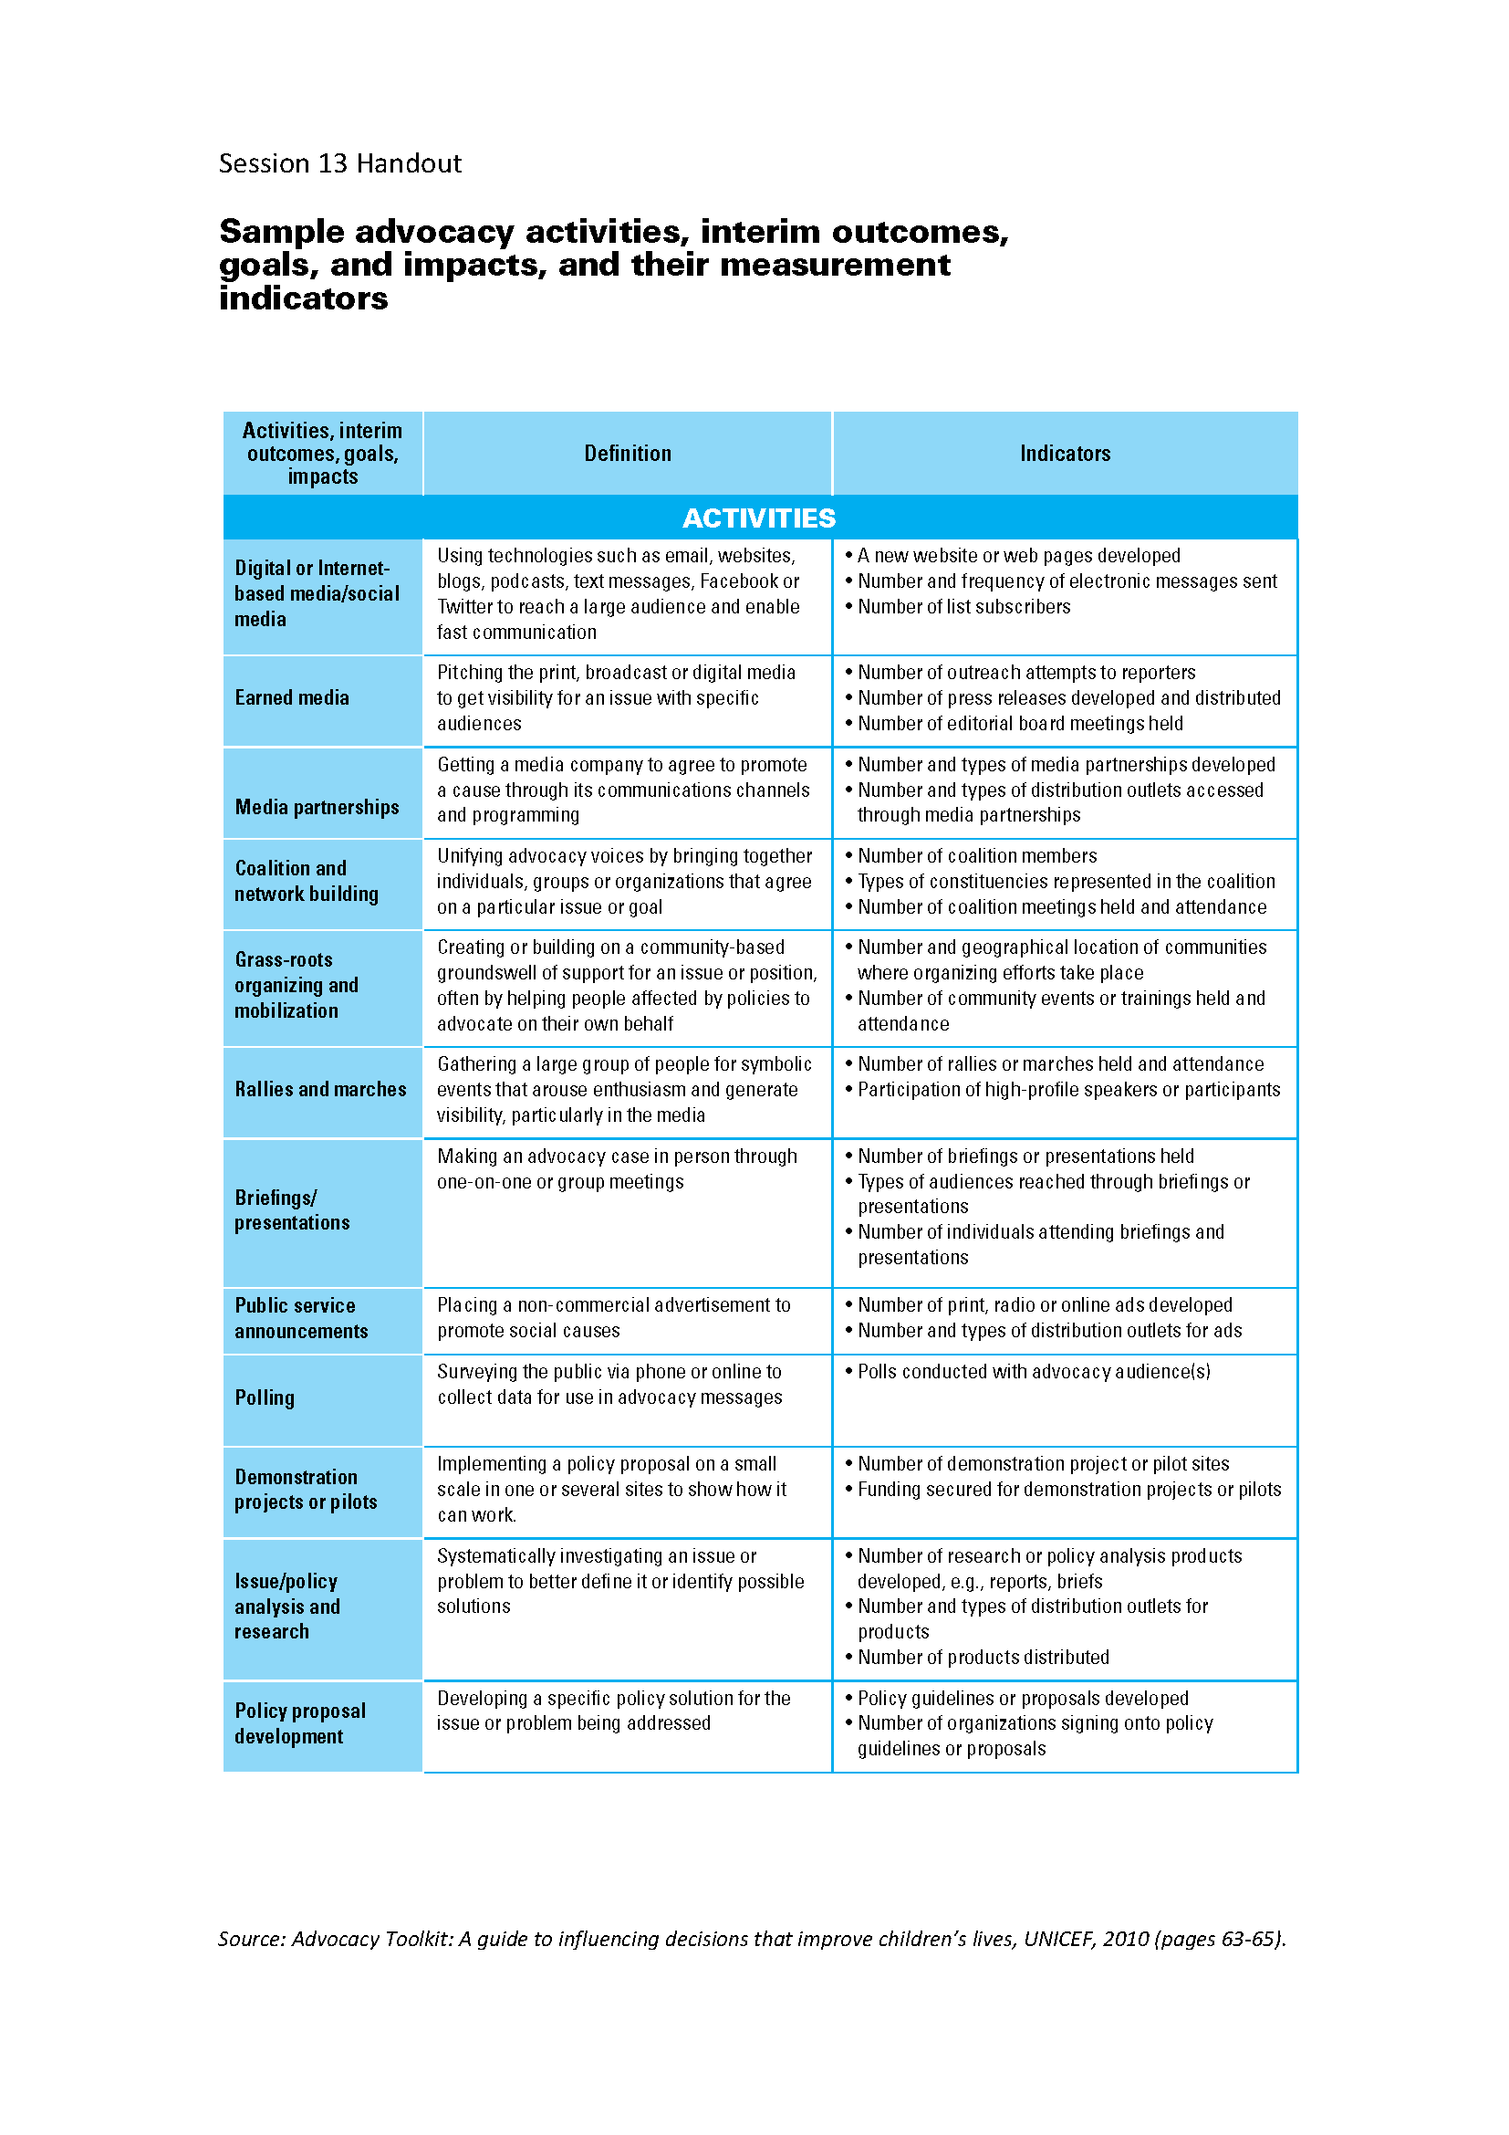
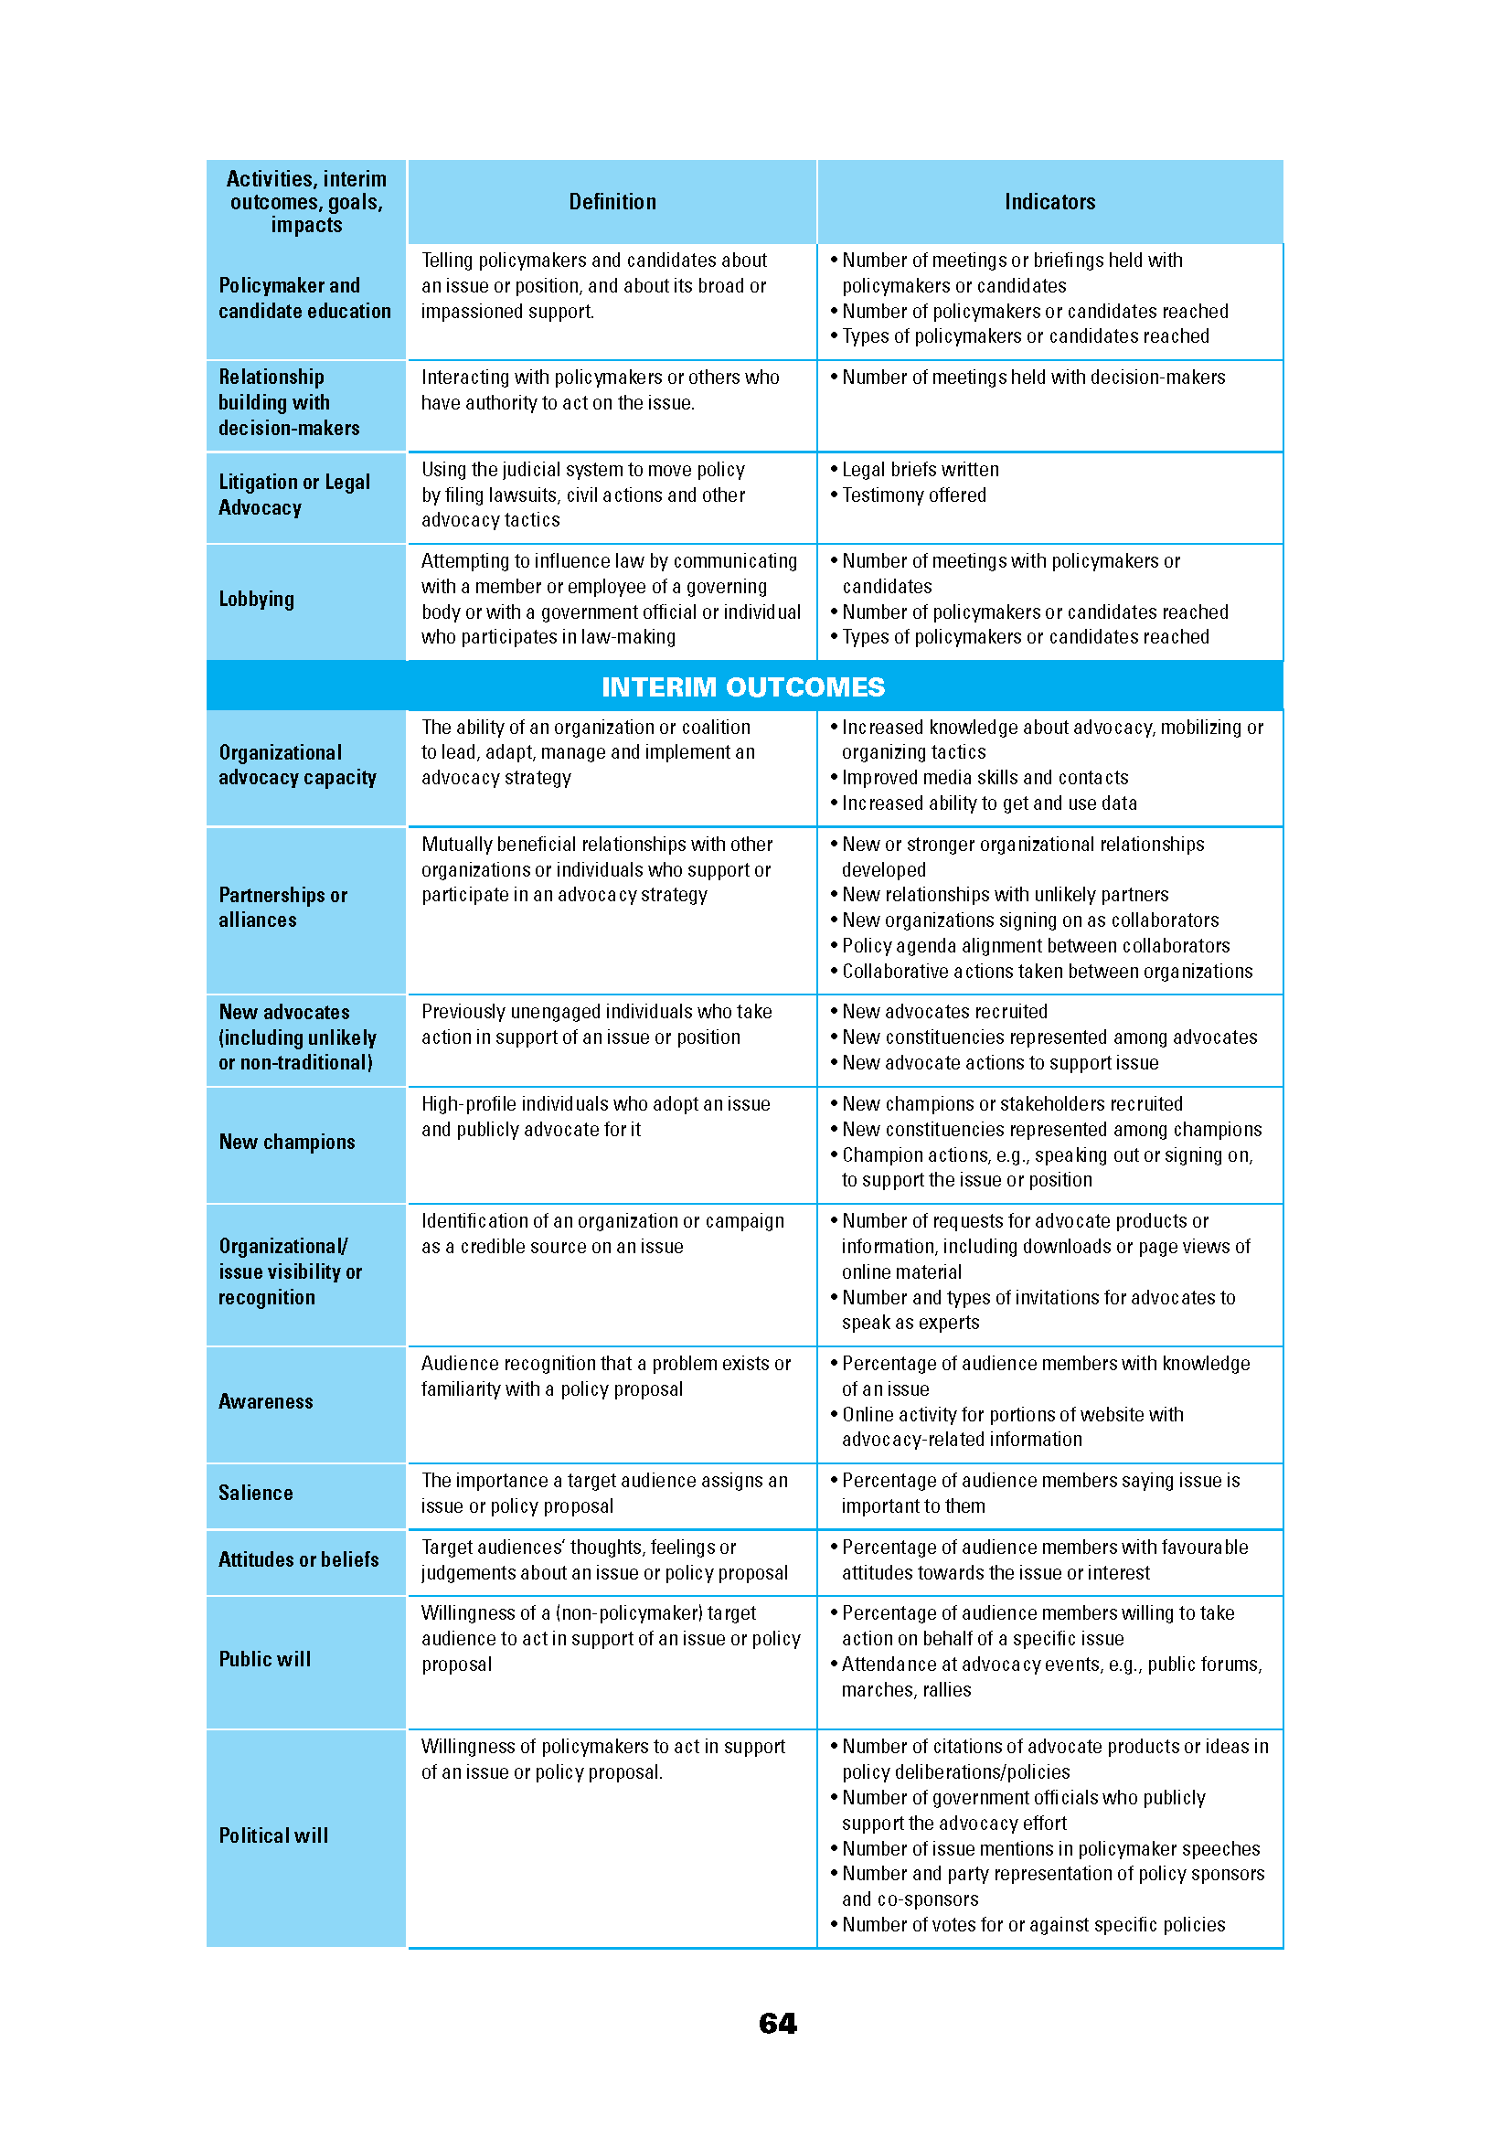
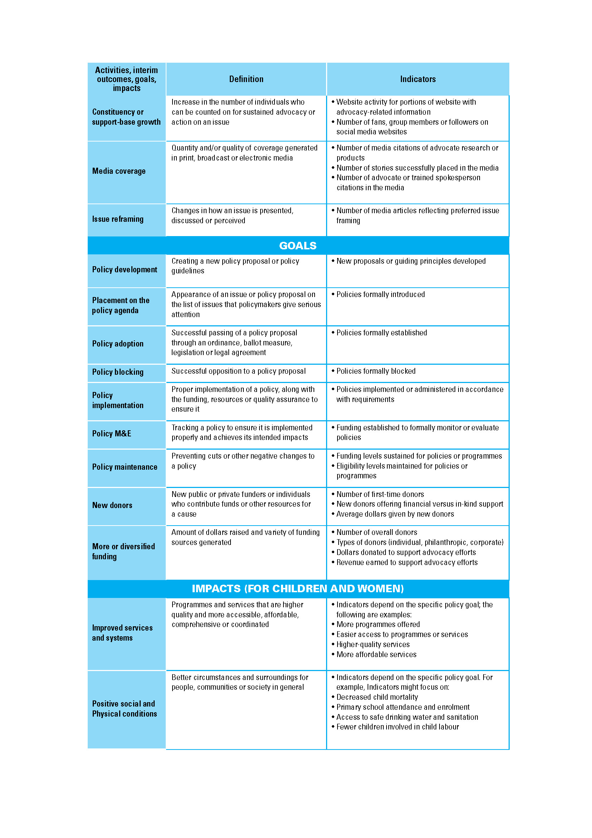
Measurement Indicators Handout

Slide 21
Activity—Drafting Indicators
Develop indicators for your strategies (small groups, 30 minutes):
1 indicator for the objective
1 indicator for at least 2 activities
Consult your handout for guidance to ensure that indicators are suitable.
Identify the data source and individual(s) responsible for collecting data.
Provide justification for selecting each indicator (related to characteristics of good indicators).
Share indicators with the large group.

Slide 22
Learning Objectives—Session 12
Define methods used to track success and evaluate advocacy
Use logic models as a tool to show progress toward advocacy goals and objectives
Describe methods for evaluating advocacy
Develop indicators for your advocacy strategy

