Slide 1
Key Concepts and Definitions

Slide 2
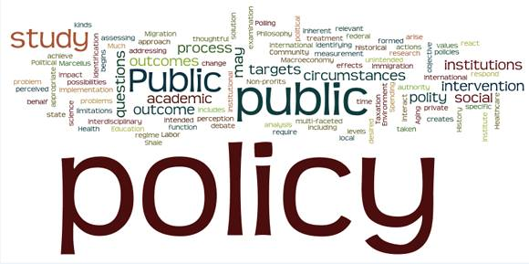
What is a Policy?
A law, rule, regulation, or a set of guidelines, procedures, or norms from a higher-level authority to guide a course of action.

Slide 3
What is Advocacy?
Advocacy is the act or process of supporting a cause or issue. An advocacy campaign is a set of targeted actions in support of a cause or issue. We advocate a cause or issue because we want to
Build support for that cause or issue
Influence others to support it
Try to influence or change legislation that affects it
— International Planned Parenthood Federation, IPPF Advocacy Guide
Advocacy is speaking up, drawing a community’s attention to an important issue, and directing decision-makers toward a solution. Advocacy is working with other people and organizations to make a difference.
— CEDPA, Cairo, Beijing and Beyond: A Handbook on Advocacy for Women Leaders

Slide 4
What is Policy Advocacy?
Policy advocacy is the deliberate process of informing and influencing decision-makers in support of evidence-based policy change.
− Stronger Health Advocates, Greater Health Impacts: A Workshop Curriculum on Policy Advocacy Strategy Development, 2013

Slide 5
Elements of the Definition
Policy advocacy is a deliberate process that requires planning and strategy.
Specifically, policy advocacy:
Aims to inform and influence decision-makers
Seeks changes that are evidence-based
Has a goal of achieving a desired policy change

Slide 6
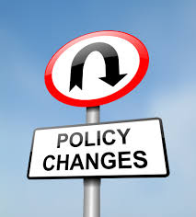
Types of Policy Change
Eliminate a harmful policy
Review or revise an existing policy
Enforce an existing policy
Develop a new policy
Fund a policy
Source: Stronger Health Advocates, Greater Health Impacts: A workshop curriculum on policy advocacy strategy development, Facilitator’s Guide, PATH, 2013.

Slide 7
Levels of Advocacy
Policy change can be made at many levels; as such, advocacy can occur at the:
International level
National level
Local level
Advocacy activities conducted at one level can affect what happens at other levels.
International
National
Local

Slide 8
Levels of Advocacy (continued)
Level(s) of your advocacy work will depend on:
The scale of the problem or issue
Where you can have the greatest impact
Resources your organization can supply (i.e., staff time, skills, and funds)
Your organization’s networks
Geographic scope of your organization

Slide 9
Discuss Policy Advocacy Experiences
1. Recall the advocacy activities you have conducted and at what level(s) they occurred.
Share your experience(s) with other participants in your small group.
Select one example from your group to share with the large group.

Slide 10
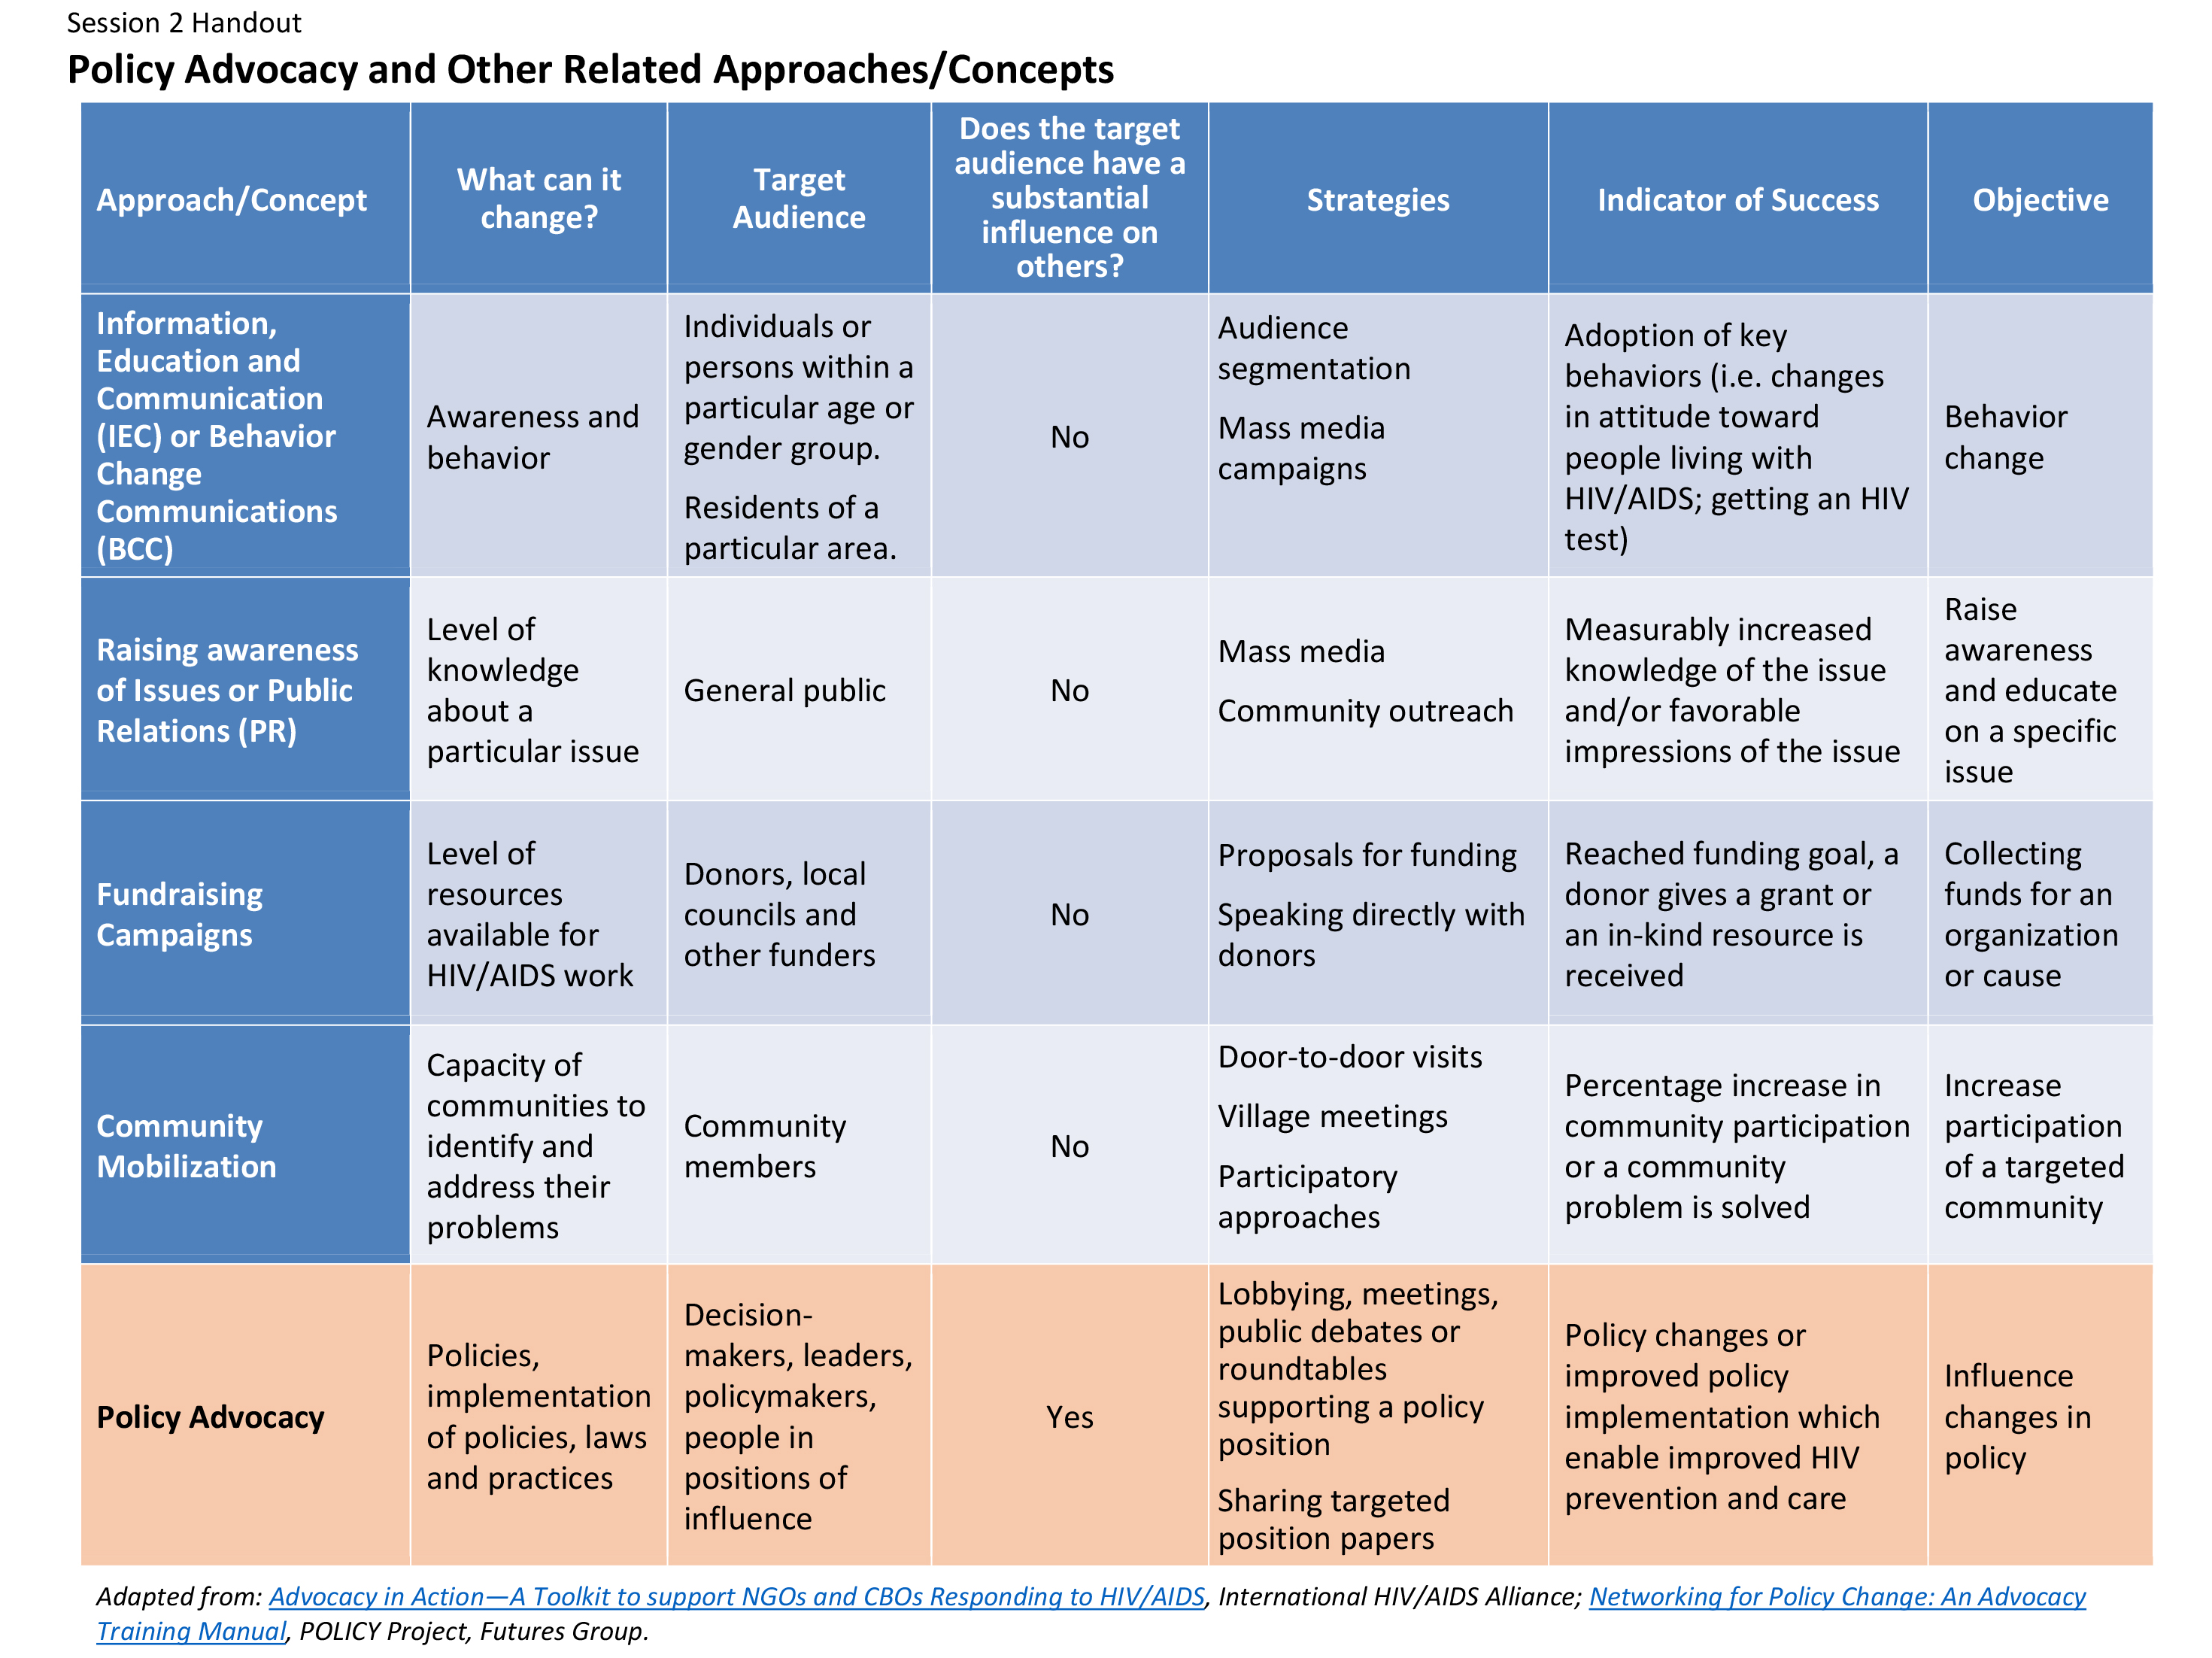
Approaches Often Confused with Policy Advocacy
Information, education, communication (IEC) or behavior change communications (BCC)
General awareness raising on issues or public relations (PR)
Fundraising
Community mobilization

Slide 11
A Closer Look at IEC/BCC and Policy Advocacy
Approach/ Concept | What Can It Change? | Target Audience | Does the Target Audience Have a Substantial Influence on Others? | Strategies | Indicator of Success | Objective
Information, education, and communication (IEC) or behavior change communications (BCC) | Awareness and behavior | Individuals or people within a particular age or gender group. Residents of a particular area. | No | Audience segmentation Mass media campaigns | Adoption of key behaviors (i.e., changes in attitudes toward people living with HIV or AIDS; getting an HIV test) | Behavior change
Policy advocacy | Policies, implement-ation of policies, laws, and practices | Decision- makers, leaders, policymakers, people in positions of influence | Yes | Lobbying, meetings, public debates, or roundtables supporting a policy position Sharing targeted position papers | Policy changes or improved policy implementation that enable improved HIV prevention and care | Influence changes in policy
Adapted from: Advocacy in Action—A Toolkit to Support NGOs and CBOs Responding to HIV/AIDS, International HIV/AIDS Alliance; Networking for Policy Change: An Advocacy Training Manual, POLICY Project, Futures Group.

Slide 12
Advocacy vs. Activism
Advocacy
Activism
Policy advocacy is the deliberate process of informing and influencing decision-makers in support of evidence-based policy change.
─ Stronger Health Advocates, Greater Health Impacts: A Workshop Curriculum on Policy Advocacy Strategy Development, PATH, 2013
The use of direct, often confrontational action, such as a demonstration or a strike, in opposition to or support of a cause.
─ The American Heritage Dictionary of the English Language, 4th Edition

Slide 13
Activity—Define Policy Advocacy
1. Select a recorder and a spokesperson.
Write your group’s definition of policy advocacy.
Remember: Include what policy advocacy is and who policy advocacy is aimed at. Specifically, policy advocacy:
Aims to inform and influence decision-makers
Seeks changes that are evidence-based
Has a goal of achieving a desired policy change

Slide 14
Discussion Questions
What are the common elements in each definition?
What are the unique elements of each definition?

Slide 15
Activity—Agree on Policy Advocacy Definition
Create a new definition combining common elements from all the small group definitions.
OR
Create a new definition by combining two or three favorite small group definitions.
OR
Select one of the small group definitions.
Write the final definition on a flip chart for use during the workshop.

Slide 16
Learning Objectives—Session 2
Define policy and policy advocacy
Differentiate between policy advocacy and other similar concepts such as activism
Develop a working definition of policy advocacy for the workshop

