Slide 1
Engage in Partnerships

Slide 2
Step 4: Engage in Partnerships
Step 4: Engage in Partnerships
Partnerships can be more effective than solo advocacy (more skills, resources, connections)
Allies: who we advocate with; people/organizations that help us to achieve our objectives and goal
Networks/alliances/coalitions: groups of organizations and individuals working together to achieve changes in policy, law, or programs for a particular issue
Different types of partnerships: informal/formal, personal/professional, temporary/ongoing

Slide 3
Strategic Reasons to Partner
Results in more organizations actively working on the issue
Brings together new constituents demonstrating wide-scale and diverse support for the issue
Improves ability to reach and persuade a wider set of policymakers and influencers
Helps to mitigate the influence of the opposition
Yields additional expertise, skills, and resources
Helps fill an organization’s advocacy gaps
Provides an element of protection or “safety in numbers”
Can bring other benefits to the participating partners
Adapted from: Stronger Health Advocates, Greater Health Impacts. PATH; 2013.

Slide 4
Effective Partnerships…
Bring resources to the advocacy effort
Are generally easy to work with
Align with your advocacy goal
Bring few risks
Adapted from: Stronger Health Advocates, Greater Health Impacts (PATH), 2013.

Slide 5
Advantages to Coalitions
Enlarge base of support significantly
Make the issue seem more legitimate when there is a mass of interest
Give partners courage (strength in numbers)
Foster a holistic, integrated viewpoint on the issue
Adapted from: Advocacy in Action; a Toolkit to support NGOs and CBOs Responding to HIV/AIDS and Networking for Policy Change: An Advocacy Training Manual, POLICY Project, Futures Group.

Slide 6
Disadvantages to Coalitions
Harder to reach consensus
Working to achieve consensus could cause delays
Trying to satisfy all members may dilute the advocacy impact
You may not always get credit for your hard work—while others may get credited for no work
Power not always equally distributed
Adapted from: Advocacy in Action: A Toolkit to Support NGOs and CBOs Responding to HIV/AIDS and Networking for Policy Change: An Advocacy Training Manual. POLICY Project, Futures Group; 2003.

Slide 7
Types of Collaboration
Less Formal
Information and data sharing
Developing common messages
Mutual consultation
Joint planning and strategizing
Coalitions and alliances
Funding
More Formal
Adapted from: Stronger Health Advocates, Greater Health Impacts (PATH), 2013.

Slide 8
Identifying Partners—Questions to Ask
Which other organizations, groups, and individuals are concerned or already acting on the same policy issue?
Do coalitions exist or do they need to be established?
What has contributed to the success or failure of other alliances or coalitions?
How are these organizations or coalitions perceived by decision-makers? Or the general public?
How can you contribute to the efforts of other organizations?
What role do these organizations want you to play and what contribution do they expect from you?
Do other organizations see you as adding value to their efforts?
Refer to your power maps!

Slide 9
Activity—Pair Share
Turn to your neighbor.
Take 5 minutes to share ideas about how to reach out to new partners.
Report ideas to large group (several volunteers).

Slide 10
Forming and Maintaining Coalitions
Elements needed to FORM a coalition
Clear purpose
Shared vision
Elements needed to MAINTAIN a coalition
Clear operational procedures
Communication system
Committed members
Mission statement
Room for flexibility in operations
Shared leadership
Trust
Wide participation by all members
Adapted from: Networking for Policy Change: An Advocacy Training Manual, 1999.

Slide 11
What Makes Coalitions Highly Effective?
Trust
Productive conflict
Accountability/ commitment
Clear/shared goals/purpose
Respect/clear roles/participation
Listening/open communication
Flexible/consensus decisions
Relationship with the public
Self-assessment/ awareness

Slide 12
Lencioni’s Five Team Functions
Embrace CONFLICT
Foster TRUST
Hold each other ACCOUNTABLE
Agree on COMMITMENTS
Attend to RESULTS
Source: Lencioni, The Five Dysfunctions of a Team; 2002.

Slide 13
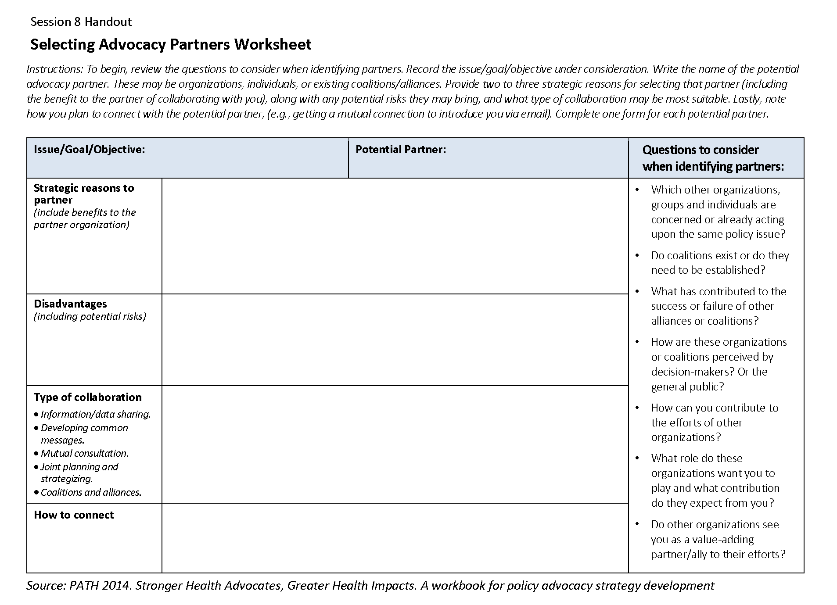
Activity—Selecting Advocacy Partners
Identify three to four potential partners for your objective (use the power maps and audience analysis tools).
Transfer the partner names to the worksheets.
For each potential partner, discuss and record the answers to each item mentioned in the first column (30 minutes).
Present one partner and one reason to partner large group (presentations 2–3 minutes/group).

Slide 14
Learning Objectives—Session 8
Explain reasons to engage in partnerships for policy advocacy
Name different types of partnerships and define their advantages and disadvantages
Describe characteristics of effective coalitions

