Slide 1
Create Effective Advocacy Communication

Slide 2
Step 5: Create Effective Advocacy Communication
Step 5: Create Effective Advocacy Communication
Effective communication translates the issue into a concise and compelling case for a target audience
A process that takes the target audience’s knowledge, interests, and skills into account
Inform
Persuade
Move to Action
Advocacy Communication Model
Source: A² Analysis and Advocacy, Advocacy Training Manual. Health Policy Initiative; 2007.

Slide 3
What is Advocacy Communication?
Inform
Persuade
Move to Action
Any planned communication activity that seeks to achieve one of the following communication goals:
Inform
Persuade
Move to action
Advocacy Communication Model
Source: A² Analysis and Advocacy, Advocacy Training Manual, Health Policy Initiative; 2007.

Slide 4
Considerations for Delivering an Advocacy Message
Stage Determination
Content/Ideas
Messenger/Source
Language
Format/Medium
Time/Place
Source: A² Analysis and Advocacy, Advocacy Training Manual, Health Policy Initiative; 2007.

Slide 5
Stage Determination
Stage Determination
Inform
Persuade
Move to Action
Use the data in the target audience analysis to determine the stage.
Collect additional information, as needed, to determine the stage.

Slide 6
Content/Ideas
A message must answer the questions:
What is the issue?
Why should the target audience care?
What is the solution and the impact on the problem?
What specifically should the target audience do?

Slide 7
Messenger/Source
Messenger/Source
Messenger: the person delivering your advocacy message or communication
The ideal messenger should:
Represent the appropriate level of seniority
Be credible with the audience
Be an effective communicator
Support your advocacy goal
Have influence with your audience

Slide 8
Other Considerations
Language
Complexity and technical depth of the language
Format/Medium
Multiple methods to communicate a message—refer to the audience analysis
Time/Place
Linked to other activities or significant locations/dates

Slide 9
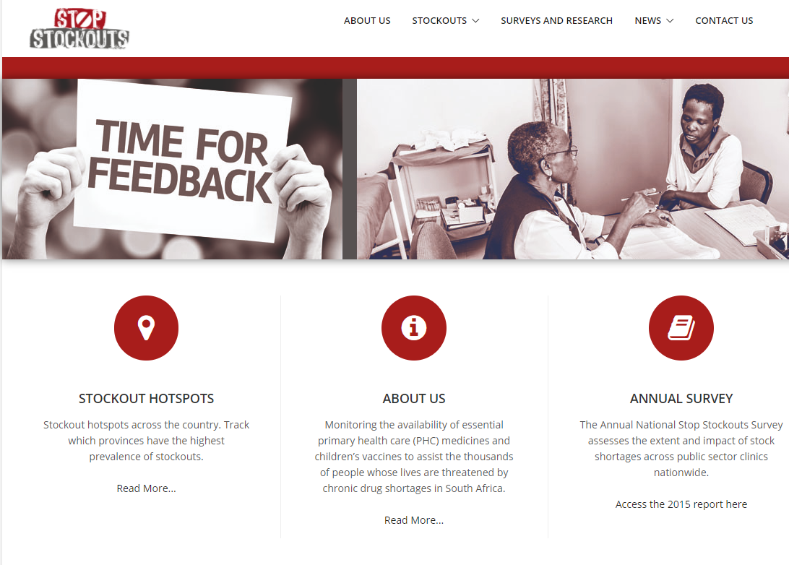
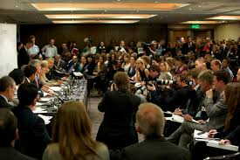
Format/Medium Examples
Website
Rally
Technical Brief and Meeting
Walkout
Press Conference

Slide 10
Activity—Developing Advocacy Messages
Components of an Advocacy Message
Why should the target audience care?
What is the issue?
What is the solution and its impact on the problem?
What specifically should the target audience do?

Slide 11
Characteristics of Effective Communication
Simple
Focused
Concise/brief
Solution-oriented
Supported by evidence
Addresses a key interest of the target audience
Appropriate language
Has a clear request
Adapted from: Stronger Health Advocates, Greater Health Impacts (PATH), 2013.

Slide 12
Questions?

Slide 13
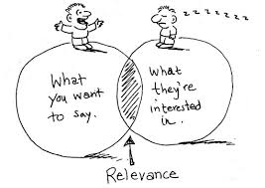
A One-Minute Message
Components of an Advocacy Message
What is the issue?
Why should the target audience care?
What is the solution and its impact?
What should the target audience do?
Adapted from: A² Analysis and Advocacy, Advocacy Training Manual, Health Policy Initiative; 2007.

Slide 14
What makes a speech compelling
Includes a “hook”
Shares data in a relatable way
Humanizes the pitch
Contains a “call to action”

Slide 15
Identify the missing component in the example below:
Members of key populations are unlikely to go for HIV testing because of stigma, discrimination, lack of confidentiality, coercion, and fear of repercussions, in addition to a lack of appropriate health services, resources, and supplies. However, because HIV incidence and prevalence are higher in key populations, it is important that key population members get tested and then linked to care if they are HIV positive. UNAIDS recommends that HIV testing services be available in locations and settings acceptable and convenient to members of key populations, including community-based services. However in ABC land, Policy 123 issued by the Ministry of Health only permits testing by trained nurse practitioners at regional facilities. During a visit to XYZ region, Sue, a sex worker, told me she’d like to go for HIV testing, but given her work hours and the stigma she feels when she travels to the regional clinic, which is two hours away, she doesn’t think she’ll go in for testing.

Slide 16
Activity—Develop a One-Minute Message
Using your current examples, develop a one-minute message (40 minutes):
Use the worksheets from the previous activities
Use the target audience from the previous activity
Decide the context
Time/place
Who is delivering the message
Role play delivery of the message
Adapted from: A² Analysis and Advocacy, Advocacy Training Manual, Health Policy Initiative; 2007.

Slide 17
Points to Remember
Content—What information does the target audience need? What stage of the model are they in?
Language—use audience-appropriate language, know their interests, situation, and vocabulary
Select a credible messenger
Choose a format/medium that enhances your message
Pick a strategic time/place for message delivery

Slide 18
Learning Objectives—Session 9
Identify the steps to develop and deliver an effective advocacy message
Develop an advocacy message based on your draft strategy
Deliver and provide feedback on a one-minute message

