Slide 1


Building the Capacity of Community Health Workers using the Healthcare Quality Improvement model: A case for Community Based Family Planning in Busia District Eastern Uganda
Ramadhan Kirunda, FHI360
22nd Feb 2017

Slide 2
Outline
Background/introduction to APC
About the QI Center of Excellence – collaborative
Methods
Results
Lessons learnt
Conclusion

Slide 3
Background
Advancing Partners and Communities (APC) Project works with the Ministry of Health (MOH) in Uganda to increase access to family planning (FP) services through Community Health Workers (Village Health Teams - VHTs) in 16 districts.
In June 2015, Advancing partners and communities (APC) project together with MOH embarked on efforts geared at establishing the first community-based family planning (CBFP) Center of Excellence (COE) in Busia district.

Slide 4
Background cont’d
This COE is a service delivery network made up of VHTs trained to provide CBFP, Health workers/midwives and CBFP clients, under supervision of District Health Office.
Its goal is to create catchment areas within the District Health System that have a high-functioning CBFP program with CHWs as core providers of family planning services.
The COE now functions as a learning site, testing and demonstrating best practices in CBFP that can guide the scale-up of high-quality CBFP services in Busia District and throughout Uganda.

Slide 5
Background cont’d
This collaborative uses a system-wide approach in trying to improve the capacity and capability of CHWs to provide quality CBFP services.
APC began this approach in Busia district with the COE, and has now scaled up in Oyam district. APC will also scale up this model in Kamwenge this year.
APC Uganda is demonstrating how the technical capacity of CHWs is enhanced through the application of the Health Care QI model to CBFP services.

Slide 6
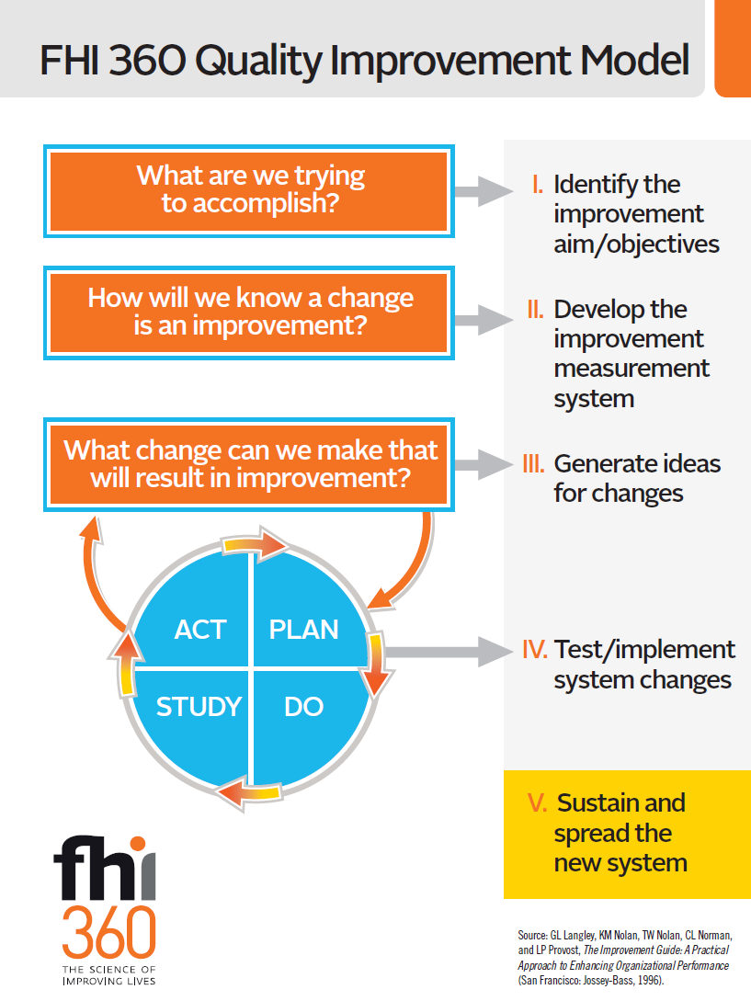
Basic QI model
  No improvement without change
  Not every change is an improvement
  Focus on systems and processes
  Work in teams
  Measure the effects of changes
  Capture clients perspectives

Slide 7
Methods
APC conducted a collaborative assessment on CBFP (Gaps – retention, counselling, male involvement)
APC trained 4 CHWs per implementing facility as QI internal coaches and two Midwives as the QI mentors.
  Internal coaches facilitate at coaching sessions and help other VHTs to track their indicators
  QI mentor offers technical support where VHTs are weak
Midwives are supported by APC to conduct client satisfaction interviews to further understand CBFP quality gaps, and address them at the monthly meeting.

Slide 8
Method cont’d
Monthly coaching sessions are conducted initially by APC together with DHO’s office, but now by the QI mentor from DHO’s office.
  QI principles
  Focus is on service standards and FP compliance requirements
  QI indicator measurement, Plotting run charts and interpretation
  Generating Improvement ideas – change package
Learning sessions bring together all QI teams from the 7 catchment areas, share experiences, learn from each other
CHW home visits are conducted regularly. Quality starts at the CHW’s home – as the main service delivery point

Slide 9
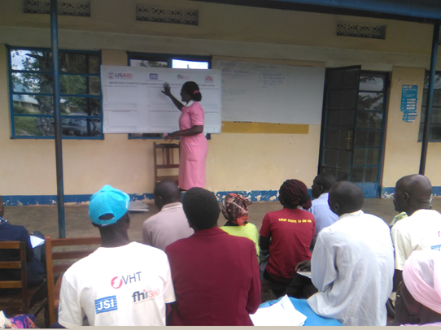

Slide 10
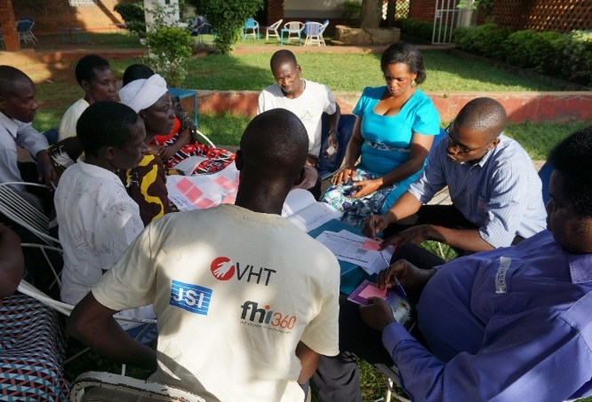

Slide 12
Summary of results June 2015 to December 2016
The proportion of female clients adequately counselled increased from 27% to 85%,
The rate of returning clients increased from 28% to 71%
CHWs given side effect counselling support by midwife increased from 0 to 67 (Average 0 – 10 per HC, per month)
Female clients counselled as a couple increased from 2% to 10%.
The number of men reached with FP information and services increased from 32 to 310 (Av: 11 – 44 Per HC Per month)

Slide 13
Results

Slide 14
Pilot

Slide 19
Lessons Learnt:
CBFP QI complements continuous medical education which improves the capability and competence of CHWs to offer and midwives to quality control CBFP services.
Through QI coaching visits there is more midwife and facility in-charge involvement in FP issues at community level, than in other CBFP districts in Uganda.
QI principles are being applied to other CHW interventions Hygiene and Sanitation, Malaria prevention…
Number of CBFP clients seeking side effect counselling and support at health centers has reduced (Midwife reports)

Slide 20
Conclusion:
Building a quality improvement culture led by CHWs at community level, with the oversight by facility based health workers, and involvement of clients can:
  Increase community confidence in CHW services,
  Strengthens the working relationship between Health facilities and CHWs – Improved accountability
  Has the potential of strengthening the bigger/national Health service system in terms of quality services

Slide 21
Acknowledgements
USAID
MOH – Quality Assurance Department
DHOs Office – Busia District
Midwives & facility incharges of CBFP sites
CHWs/VHTs implementing the CBFP program
Clients
Other implementing Partners
Thank you!

