Slide 1
The Policy Development Process

Slide 2
Definitions
Policy—a law, rule, regulation, or a set of guidelines, procedures, or norms from a higher-level authority to guide a course of action
Policymaker—a ​member of a government department, ​legislature, or other organization responsible for policy change
Policymaking—a course of action dealing with a problem or matter of concern

Slide 3
Example Policy Process
Source: Meier, 1991
http://www.policynl.ca/policydevelopment/pages/policymodels.html

Slide 4
Example Policy Process
Source: Grindle and Thomas, 1991

Slide 5
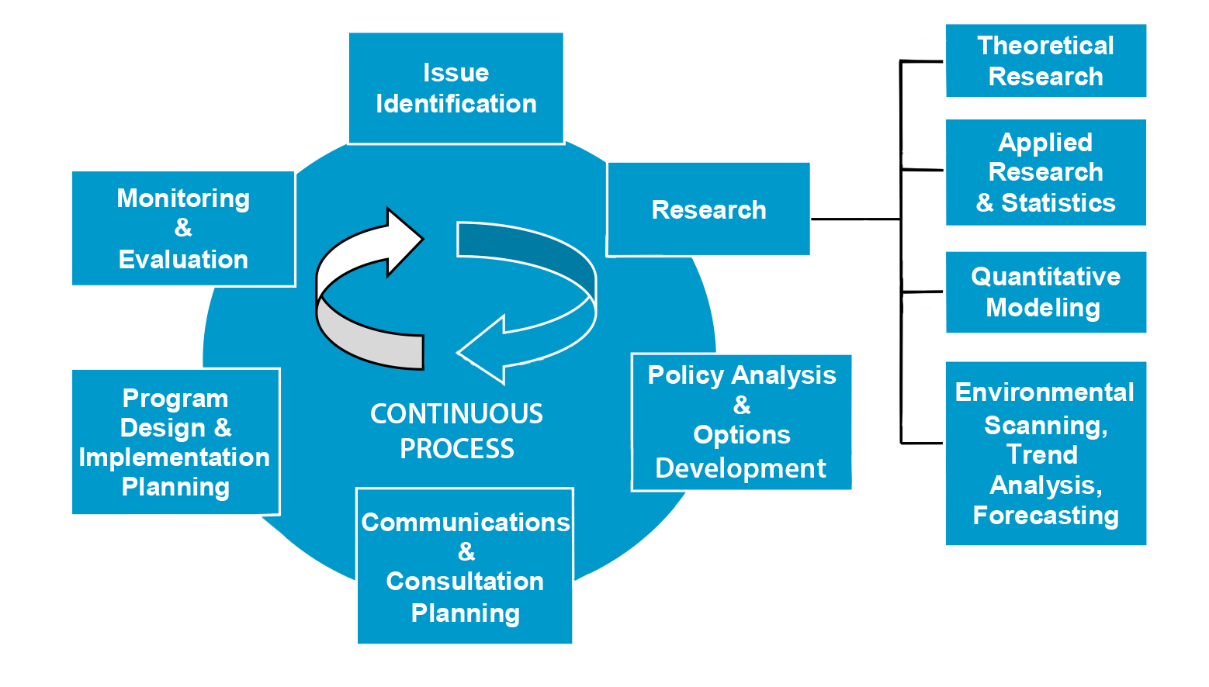
Example Policy Process
Source: A Guide to Policy Development and Management in Uganda, 2013

Slide 6
Generic Steps in the Policy Development Process
1. Problem Identification
2. Policy Formulation
3. Placement on the Policy Agenda
4. Adoption of Policy Change
5. Policy Implementation
6. Outcome Monitoring and Evaluation
Adapted from: AFMC Primer on Population Health, 2013.

Slide 7
Policy Development Process—Step 1 Problem Identification
Articulate the issue
Determine if the problem requires a policy solution
Examples of Identified Issues | Is a Policy Action Needed?
Youth are the most vulnerable, but no data on HIV risk behavior, prevention, and access to HIV counseling and testing
Yes (to ensure that needed data are collected)
A private clinic that provides critical HIV services to key populations is about to close due to lack of funds, leaving hundreds without care
No (fundraising is needed to reopen clinic or government facilities must prepare to fill the gap )
Workers with HIV are fired or discriminated against in the workplace
Yes
Adapted from: A2 Advocacy Training Manual. Analysis and Advocacy (A2) Project; 2007.

Slide 8
Policy Development Process—Step 2 Policy Formulation
Determine potential solutions
Evaluate solutions to select the most appropriate
Examples of Identified Issues | Is a Policy Action Needed? | Types of Policy Actions to Be Considered
Workers with HIV are fired or discriminated against in the workplace
Businesses can consider anti-discriminatory workplace policies
Labor ministry can implement a system to regularly collect data on discrimination against people living with HIV or AIDS (PLWHA)
Yes

Slide 9
Policy Development Process—Step 3 Placement on the Policy Agenda
Examples of Identified Issues | Is a Policy Action Needed? | Types of Policy Actions to Be Considered | Decision-makers and Agenda Items
Workers with HIV are fired or discriminated against in the workplace | Yes | Businesses can consider anti-discriminatory workplace policies Labor ministry can set up a system to regularly collect data on discrimination against PLWHA
 |  |  | Board of directors for in-country company appoints a working group to review workplace policies and develop a report with recommendations by the next board meeting Ministry of Labor task force on discrimination adds item to annual budgetary meeting agenda

Slide 10
Policy Development Process—Step 4 Adoption of Policy Change
Formal acceptance of the policy by the decision- maker or decision-making body
Examples of Identified Issues | Types of Policy Actions to Be Considered | Decision-makers and Agenda Items | Policy Adoption
Workers with HIV are fired or discriminated against in the workplace | Businesses can consider anti-discriminatory workplace policies | Board of directors for in-country company appoints a working group to review workplace policies
 |  |  | Board of directors reviews recommendations from the working group and puts in place an anti-discrimination program

Slide 11
Policy Development Process—Step 5 Policy Implementation
The policy change decision is put into effect.
The policy may or may not be implemented by the decision-maker/decision-making body.
The body that implements the policy may also interpret the language in the policy.

Slide 12
Policy Development Process—Step 6 Outcome Monitoring and Evaluation
Process and outcome assessments and evaluations
To ensure the policy has been properly implemented
To determine whether the desired outcomes were achieved

Slide 13
Policy Cycle
Outcome Monitoring and Evaluation
Problem Identification
Policy Implementation
POLICY CYCLE
Policy Formulation
Adoption of Policy Change
Placement on the Policy Agenda

Slide 14
Activity—Where does advocacy fit in?
Outcome Monitoring and Evaluation
Problem Identification
Policy Implementation
POLICY CYCLE
Policy Formulation
Adoption of Policy Change
Placement on the Policy Agenda

Slide 15
Remember: Advocacy occurs throughout the policy cycle.
For advocacy to be effective, you must:
Know the policy process
Know the timing
Know where you can influence

Slide 16
Learning Objectives—Session 3
Describe common elements of the policy development process after reviewing several policy development frameworks
Agree on a set of steps for a generic policy development process based on reviewed examples
Describe the types of advocacy activities that occur during the steps in the policy development process

Slide 17
Policy Development Process—Step 2 Policy Formulation
Determine potential solutions
Evaluate solutions to select the most appropriate one(s)
Examples of Identified Issues | Is a Policy Action Needed? | Types of Policy Actions to Be Considered
Youth are the most vulnerable, but no data on HIV risk behavior, prevention, and access to HCT | Yes (to ensure that needed data are collected)
MOH could start a behavioral surveillance survey (BSS)
Youth centers could develop guidelines for confidential HIV counseling and testing (HCT) in youth-friendly centers
Workers with HIV are fired or discriminated against in the workplace
Yes
Businesses can consider anti-discriminatory workplace policies
Labor ministry can set up system to regularly collect data on discrimination against PLWHA

Slide 18
Policy Development Process—Step 3 Placement on the Policy Agenda
Examples of Identified Issues | Is a Policy Action Needed? | Types of Policy Actions to Be Considered | Decision-makers and Agenda Items
Youth are the most vulnerable, but no data on HIV risk behavior, prevention, and access to HCT | Yes (to ensure that needed data are collected) | Ministry of Health (MOH) could start a BSS Youth centers could develop guidelines for confidential HCT in youth-friendly centers | MOH technical working group on M&E places BSS funding on annual meeting agenda The Board of Youth-Friendly Centers adds item to quarterly board meeting topics
Workers with HIV are fired or discriminated against in the workplace | Yes | Businesses can consider anti-discriminatory workplace policies Labor ministry can set up system to regularly collect data on discrimination against PLWHA | Board of directors for in-country company appoints a working group to review workplace policies and develop a report with recommendations by the next board meeting Ministry of Labor task force on discrimination adds item to annual budgetary meeting agenda

Slide 19
Policy Development Process—Step 4 Adoption of Policy Change
Formal acceptance of the policy by the decision- maker or decision-making body
Examples of Identified Issues | Types of Policy Actions to be Considered | Decision-makers and Agenda Items | Policy Adoption
Youth are the most vulnerable, but no data on HIV risk behavior, prevention, and access to HCT | MOH could start a BSS Youth centers could develop guidelines for confidential HCT in youth-friendly centers | MOH technical working group on M&E places BSS funding on annual meeting agenda | MOH technical working group on M&E presents BSS implementation and funding proposal for review and approval at the MOH budget meeting

